Slide 1
IoT

Slide 2
The Internet of Things (IoT) is the network of physical objects or "things" embedded with electronics, software, sensors, and network connectivity, which enables these objects to collect and exchange data.

Slide 3
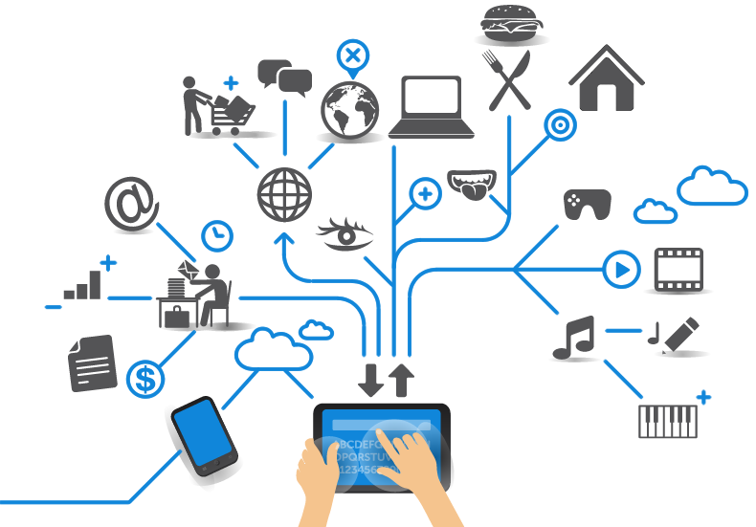
Characteristics:
Interconnectivity
Things-related services
Heterogeneity
Dynamic changes
Enormous scale
Notes:
Internet of things (IoT): A global infrastructure for the information society, enabling advanced services by interconnecting (physical and virtual) things based on existing and evolving interoperable information and communication technologies.
NOTE 1 – Through the exploitation of identification, data capture, processing and communication capabilities, the IoT makes full use of things to offer services to all kinds of applications, whilst ensuring that security and privacy requirements are fulfilled.
NOTE 2 – From a broader perspective, the IoT can be perceived as a vision with technological and societal implications.
The fundamental characteristics of the IoT are as follows:
– Interconnectivity: With regard to the IoT, anything can be interconnected with the global information and communication infrastructure.
– Things-related services: The IoT is capable of providing thing-related services within the constraints of things, such as privacy protection and semantic consistency between physical things and their associated virtual things. In order to provide thing-related services within the constraints of things, both the technologies in physical world and information world will change.
– Heterogeneity: The devices in the IoT are heterogeneous as based on different hardware platforms and networks. They can interact with other devices or service platforms through different networks.
– Dynamic changes: The state of devices change dynamically, e.g., sleeping and waking up, connected and/or disconnected as well as the context of devices including location and speed. Moreover, the number of devices can change dynamically.
– Enormous scale: The number of devices that need to be managed and that communicate with each other will be at least an order of magnitude larger than the devices connected to the current Internet. The ratio of communication triggered by devices as compared to communication triggered by humans will noticeably shift towards device-triggered communication. Even more critical will be the management of the data generated and their interpretation for application purposes. This relates to semantics of data, as well as efficient data handling.

Slide 4
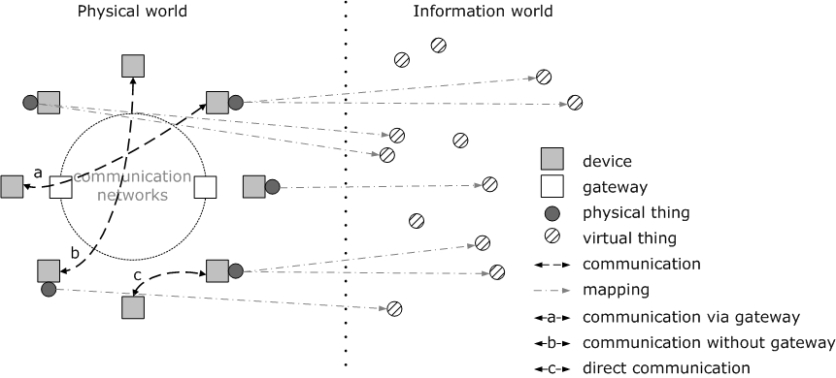
Notes:
The following provide high-level requirements which are relevant for the IoT:
– Identification-based connectivity: The IoT needs to support that the connectivity between a thing and the IoT is established based on the thing's identifier. Also, this includes that possibly heterogeneous identifiers of the different things are processed in a unified way.
– Interoperability: Interoperability needs to be ensured among heterogeneous and distributed systems for provision and consumption of a variety of information and services. 6 Rec. ITU-T Y.2060 (06/2012)
– Autonomic networking: Autonomic networking (including self-management, self-configuring, self-healing, self-optimizing and self-protecting techniques and/or mechanisms) needs to be supported in the networking control functions of the IoT, in order to adapt to different application domains, different communication environments and large numbers and types of devices.
– Autonomic services provisioning: The services need to be able to be provided by capturing, communicating and processing automatically the data of things based on the rules configured by operators or customized by subscribers. Autonomic services may depend on the techniques of automatic data fusion and data mining.
– Location-based capabilities: Location-based capabilities need to be supported in the IoT. Something-related communications and services will depend on the location information of things and/or users. It is needed to sense and track the location information automatically. Location-based communications and services may be constrained by laws and regulations, and should comply with security requirements.
– Security: In the IoT, every 'thing' is connected which results in significant security threats, such as threats towards confidentiality, authenticity and integrity of both data and services. A critical example of security requirements is the need to integrate different security policies and techniques related to the variety of devices and user networks in the IoT.
– Privacy protection: Privacy protection needs to be supported in the IoT. Many things have their owners and users. Sensed data of things may contain private information concerning their owners or users. The IoT needs to support privacy protection during data transmission, aggregation, storage, mining and processing. Privacy protection should not set a barrier to data source authentication. – High quality and highly secure human body related services: High quality and highly secure human body related services needs to be supported in the IoT. Different countries have different laws and regulations on these services. NOTE
– Human body related services refer to the services provided by capturing, communicating and processing the data related to human static features and dynamic behaviour with or without human intervention.
– Plug and play: Plug and play capability needs to be supported in the IoT in order to enable on-the-fly generation, composition or the acquiring of semantic-based configurations for seamless integration and cooperation of interconnected things with applications, and responsiveness to application requirements.
– Manageability: Manageability needs to be supported in the IoT in order to ensure normal network operations. IoT applications usually work automatically without the participation of people, but their whole operation process should be manageable by the relevant parties.

Slide 5
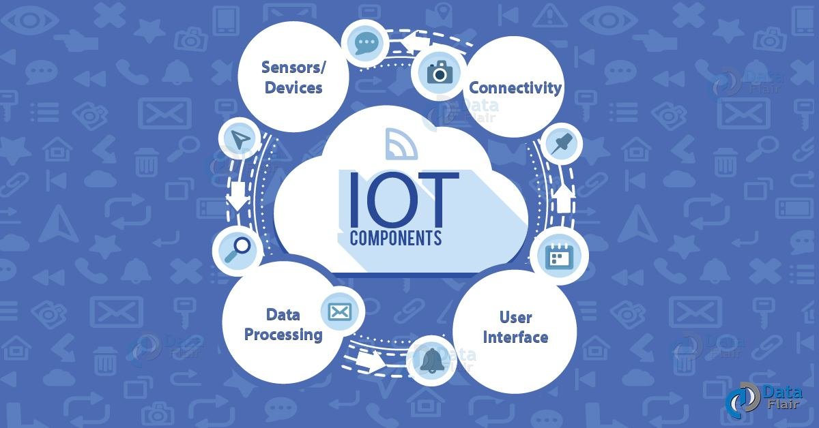

Slide 6
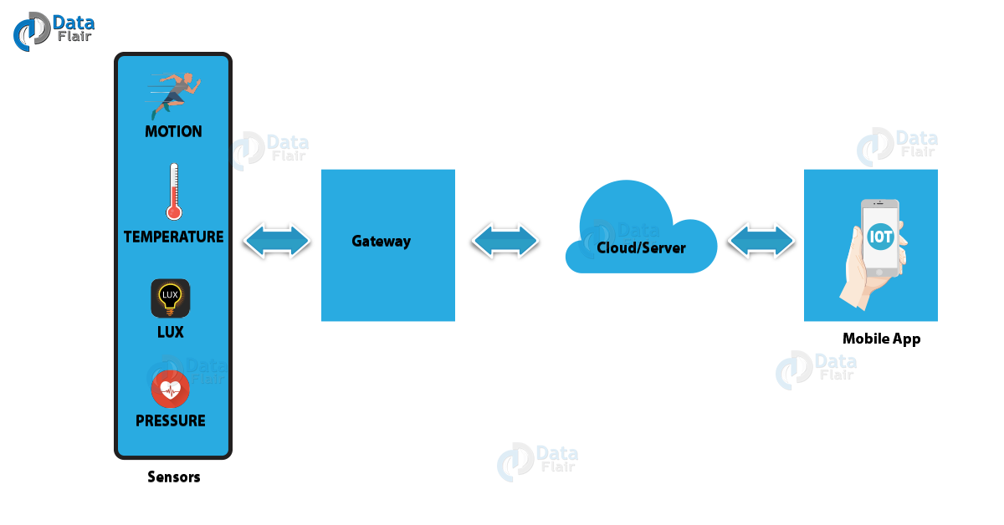

Slide 7
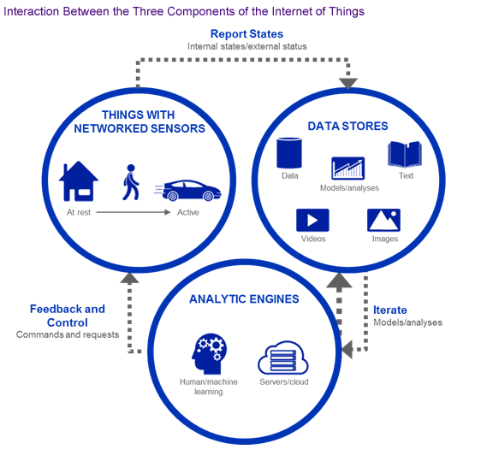

Slide 8
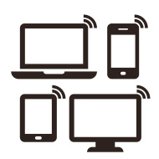




Through the exploitation of identification, data capture, processing and communication capabilities, IoT makes full use of “things" to offer services to all kinds of applications, whilst ensuring that security and privacy requirements are fulfilled.
ANALYTICS: Data processing
Data capturing
Data communicating
ACTION: Informed decision-making
Notes:
IoT is a technology network, including sensors, machines, and other devices, that is connected to the internet and communicates massive amounts of data from machine to machine (M2M), enabling more efficiency and better real time decisions on a scalable basis.

Slide 9
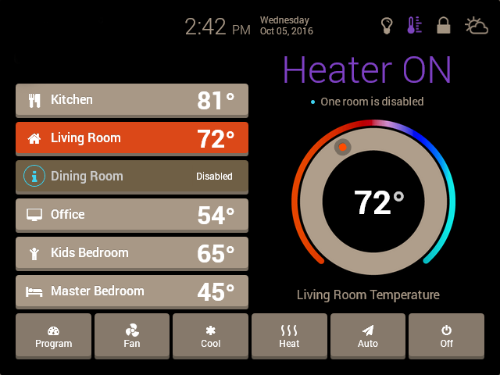

Slide 10
These devices collect useful data with the help of various existing technologies and then autonomously flow the data between other devices.

Slide 11
Criticisms and Controversies of IoT
Privacy
Security
Autonomy and Control
Design
Environmental impact

Slide 12
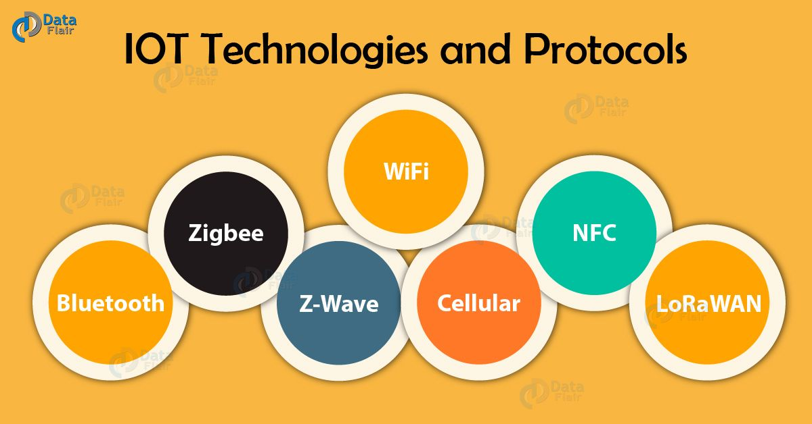

Slide 13
An actuator operates in the reverse direction of a sensor. It takes an electrical input and turns it into physical action.
In a typical IoT system, a sensor may collect information and route to a control center where a decision is made and a corresponding command is sent back to an actuator in response to that sensed input.

Slide 14
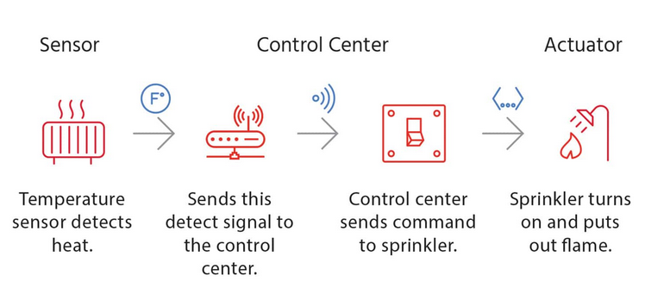

Slide 15
Types of sensors
There are various types of sensors such as position, temperature, pressure, speed sensors, but fundamentally there are two types – analog and digital.
A digital sensor is incorporated with an Analog-to-digital converter while analog sensor does not have any ADC.

Slide 16
Differences Between Sensors and Actuators
A sensor is a device that changes a physical parameter to an electrical output. As against, an actuator is a device that converts an electrical signal to a physical output.
The sensor is situated at the input port to take the input, whereas an actuator is placed at the output port.
Sensor generates electrical signals while an actuator results in the production of energy in the form of heat or motion.
Magnetometer, cameras, microphones are some of the examples in which the sensor is used. In contrast, actuators are used in the LED, loudspeaker, motor controllers, laser etc..

Slide 17
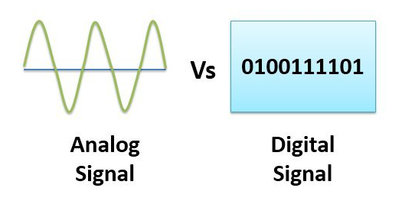
Analog and Digital Signal

Slide 18
Analog signal is a kind of continuous wave form that changes over time.
An analog signal is described using amplitude, period or frequency and phase.
Amplitude marks the maximum height of the signal.
Frequency marks the rate at which signal is changing.
Phase marks the position of the wave with respect to time zero.

Slide 19
An analog signal is not immune to noise hence, it faces distortion and decrease the quality of transmission. The range of value in an analog signal is not fixed.

Slide 20
Digital signal is noncontinuous, discrete time signal.
Digital signal carries information or data in the binary form i.e. a digital signal represent information in the form of bits.
Digital signal is described with bit rate and bit interval.
Bit interval describes the time require for sending a single bit.
Bit rate describes the frequency of bit interval.

Slide 21
A digital signal is more immune to the noise; hence, it hardly faces any distortion. Digital signals are easier to transmit and are more reliable when compared to analog signals. Digital signal has a finite range of values. The digital signal consists 0s and 1s.

Slide 22
Sensor data is the output of a device that detects and responds to some type of input from the physical environment. The output may be used to provide information or input to another system or to guide a process.

Slide 23
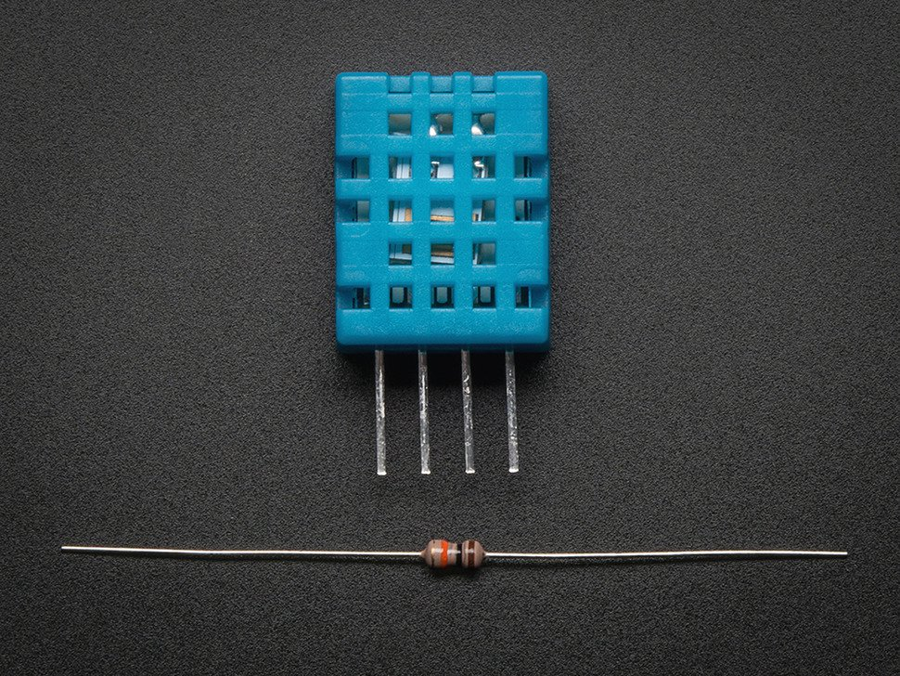

Slide 24
It used to measure the surrounding air, and spits out a digital signal on the data pin.
Its fairly simple to use, but requires careful timing to grab data.
The disadvantage of this sensor is you can only get new data from it once every 2 seconds

Slide 25
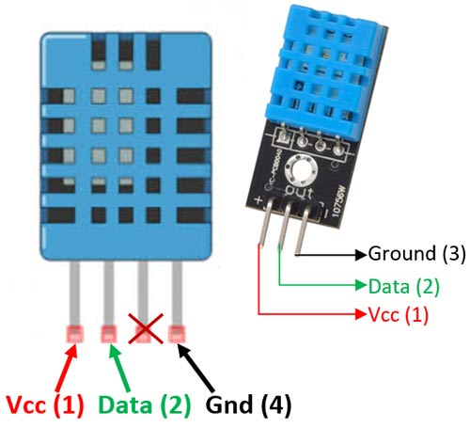

Slide 26
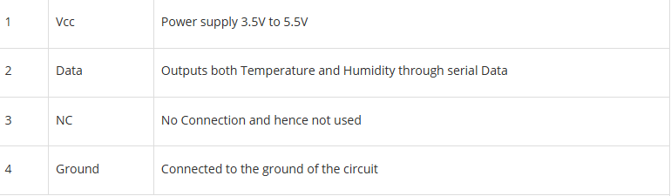

Slide 27
microcontroller
A microcontroller is a single chip containing at least a CPU, non-volatile memory, volatile memory, a timer and an I/O control unit. Microcontroller can be described as a computer on a chip.

Slide 28
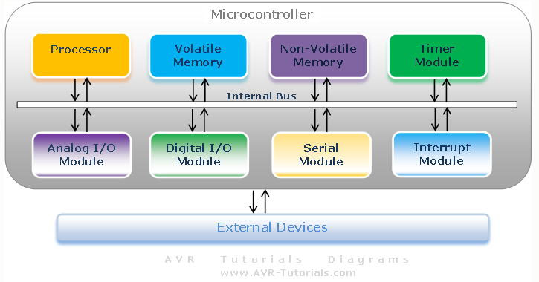

Slide 29
Processor - The processor refers to the Central Processing Unit (CPU) of the microcontroller. It contains the Arithmetic Logic Unit (ALU), Control Unit, Instruction Decoder and some Special Registers . Volatile Memory - This is memory used by the microcontroller for temporary data storage, system setup and peripherals configurations.
Non-Volatile Memory - This is memory used by the microcontroller to store programs. Data can also be stored in this memory but the access time is much slower than that of RAM. Memory in this category includes ROM, PROM, EPROM, EEPROM and FLASH.

Slide 30
Timer Module - Most microcontrollers have at least one timer/counter peripheral. Timer/Counter modules are used to perform timing or counting operations in the controller. These include time stamping, measuring intervals, counting events, etc. Interrupt Module - Interrupts enable the microcontroller to monitor certain events in the background while executing and application program and react to the event if necessary pausing the original program. This is all coordinated by the interrupt module.

Slide 31
Digital I/O Module - This module allows digital/logic communication with the microcontroller and the external world. Analog I/O Modules - These modules are use to input/output analog information from/to the external world. Analog modules include Analog Comparators and Analog-to-Digital Converters. Serial Modules - These modules are used for serial communication with the external world. An example is the peripherial which utilizes the RS232 standard.

Slide 32
Breadboard
A breadboard is a rectangular plastic board with a bunch of tiny holes in it. These holes let you easily insert electronic components to prototype (meaning to build and test an early version of) an electronic circuit, like this one with a battery, switch, resistor, and an LED (light-emitting diode).

Slide 33
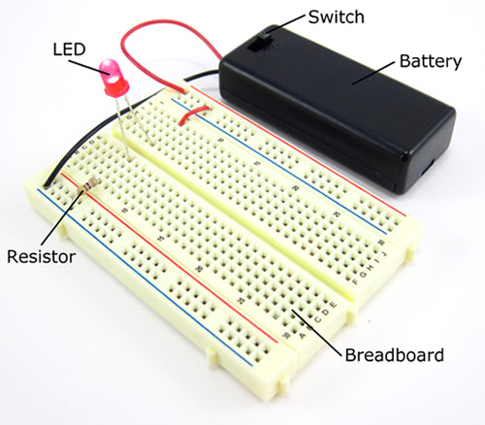

Slide 34
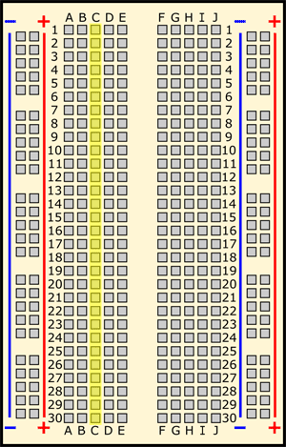

Slide 35
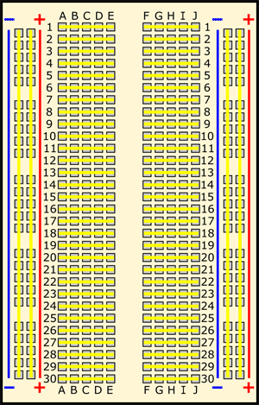

Slide 36
Arduino

Slide 37
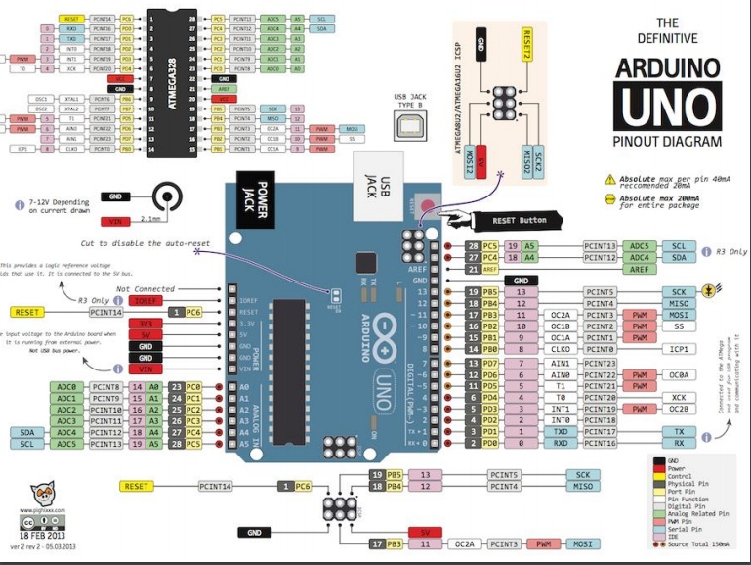

Slide 38
Programming in Arduino
Open Source electronic prototyping platform based on flexible easy to use hardware and software.

Slide 39
Variable declaration rules:
A variable name cannot have a space or special characters, except for underscore(_).
A variable name can be alphanumeric in nature
A variable name cannot start with a number. It would have to start with an alphabet character or ‘_’
A variable name can contain uppercase and lowercase characters
You cannot use a keyword (example ‘int’,’void’ and so on) as a variable name

Slide 40
There are two different types of comments, single line comments, and multi-line comments.
Single line comments are written using ‘//’ and do not need a termination. Multiline comments start with ‘/*’ and end with ‘*/’

Slide 41
Semicolon (;)
Semicolon should be used after every statement. The IDE will throw an error if a semicolon is not used at the end of a statement.

Slide 42
Setup()
The setup function is used to define the setup parameters for the arduino board.
It is called only when the Arduino is powered on or reset.
It is used to initialize variables and pin modes

Slide 43
Loop()
The code in the loop function is executed by the arduino board
The loop functions runs continuously till the device is powered off.
The main logic of the code goes here.
Similar to while (1) for micro-controller programming.

Slide 44
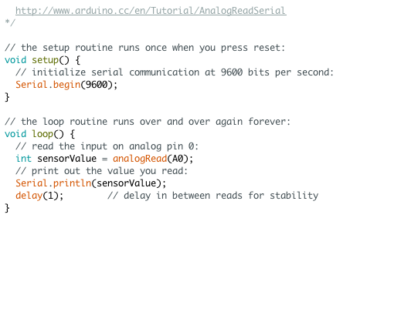

Slide 45
pinMode()
Syntax : pinMode(pin, mode)
A pin on arduino can be set as input or output by using pinMode function.
pinMode(13, OUTPUT); // sets pin 13 as output pin
pinMode(13, INPUT); // sets pin 13 as input pin

Slide 46
void setup() { pinMode(13, OUTPUT); // sets the digital pin 13 as output
}
void loop() {
digitalWrite(13, HIGH); // sets the digital pin 13 on
delay(1000); // waits for a second
digitalWrite(13, LOW); // sets the digital pin 13 off
delay(1000); // waits for a second
}

Slide 47
digitalWrite()
Write a HIGH or a LOW value to a digital pin.
Syntax:
digitalWrite(pin, value)
Parameters
pin: the Arduino pin number. value: HIGH or LOW.
Returns
Nothing

Slide 48
digitalWrite(13, LOW); // Makes the output voltage on pin 13 , 0V
digitalWrite(13, HIGH); // Makes the output voltage on pin 13 , 5V
int buttonState = digitalRead(2); // reads the value of pin 2 in buttonState

Slide 49
Libraries are a collection of code that makes it easy for you to connect to a sensor, display, module, etc. For example, the built-in LiquidCrystal library makes it easy to talk to character LCD displays. There are hundreds of additional libraries available on the Internet for download.

Slide 50
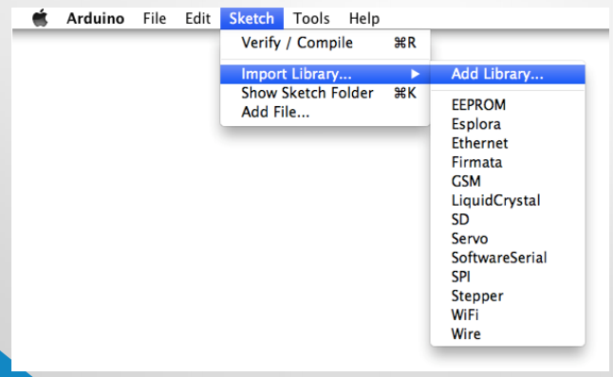

Slide 51
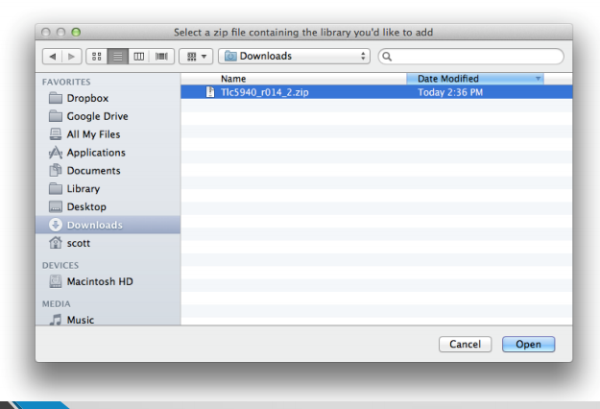

Slide 52
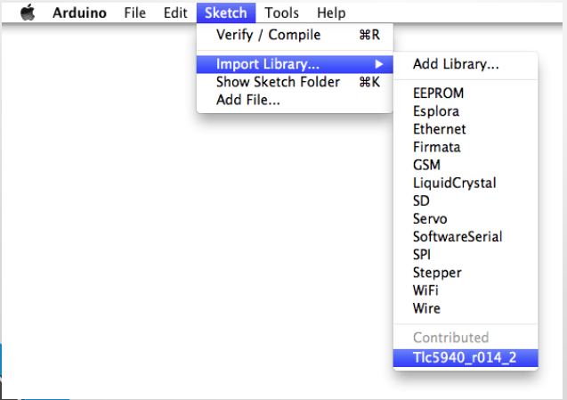

Slide 53
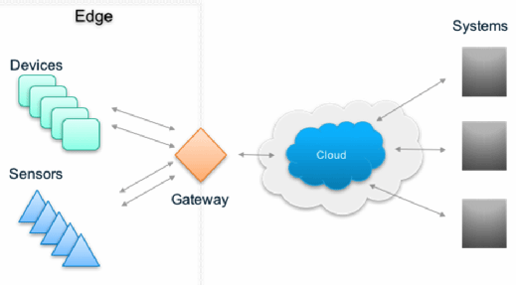

Slide 54
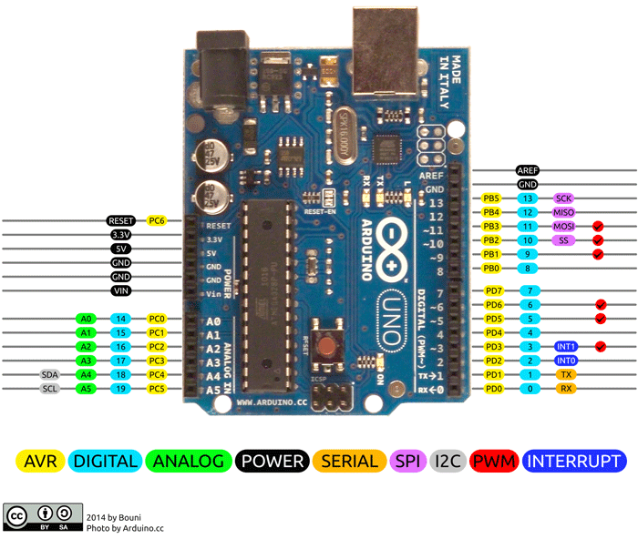

Slide 55
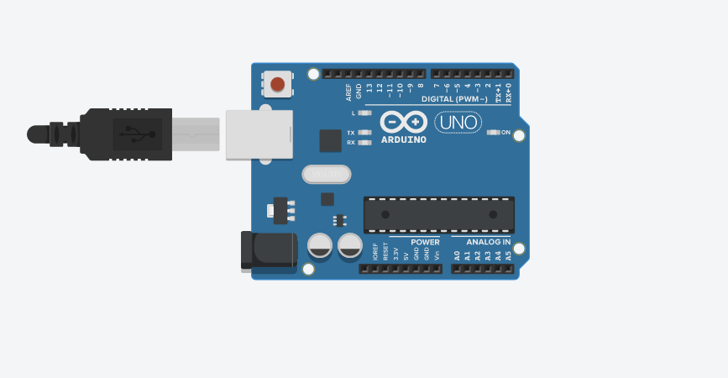

Slide 56
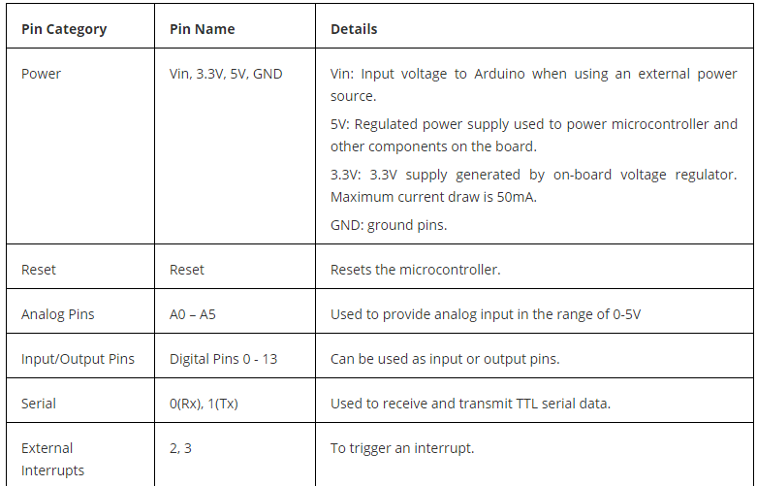

Slide 57
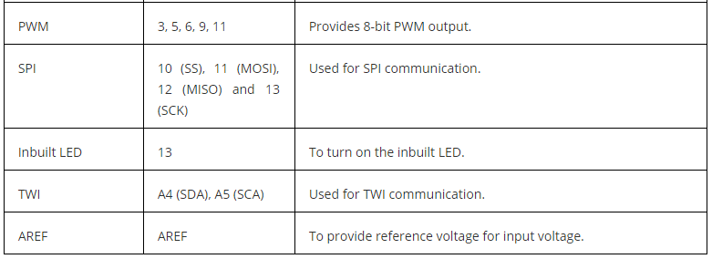

Slide 58
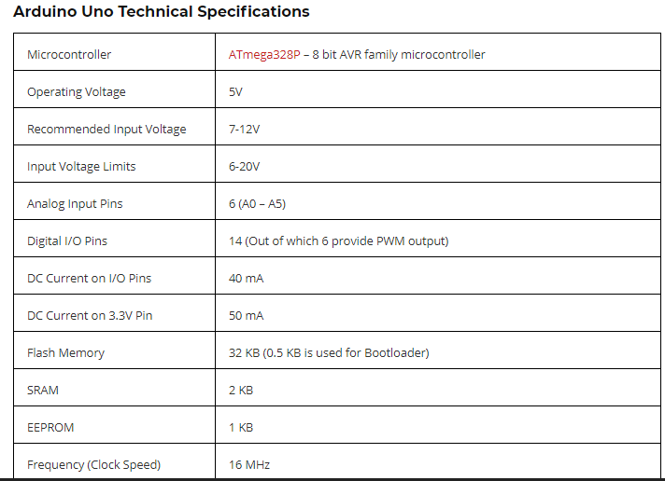

Slide 59
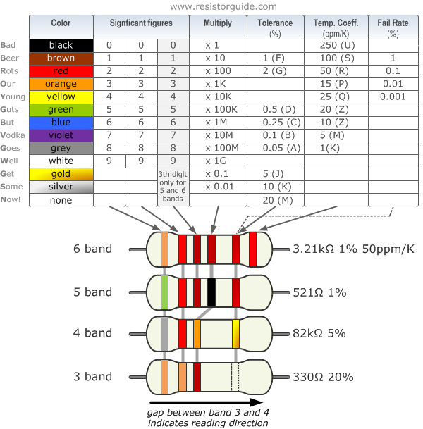

Slide 60
Sensors and actuators
The intelligence and value from an IoT system is based on what can be learned from the data. Sensors are the source of IoT data.
A sensor is any physical device that converts one form of energy into another. It converts some physical phenomenon into an electrical impulse that can then be interpreted to determine a reading.

Slide 61
microcontroller
A microcontroller is a single chip containing at least a CPU, non-volatile memory, volatile memory, a timer and an I/O control unit. Microcontroller can be described as a computer on a chip.

Slide 63
Protocol
It is a digital language through which we communicate with others on the Internet.
protocol meaning is that it a set of mutually accepted and implemented rules at both ends of the communications channel for the proper exchange of information.
Message travel from sender to receiver via a medium (The medium is the physical path over which a message travels) using a protocol.

Slide 64
Protocols' are developed by industry wide organizations.
All data of protocols are stored in binary information. Protocol language is a mixture of bits, characters, integers, etc.

Slide 65
Each of it has its own access method of exchanging data over a computer network, such as LAN, Internet, Intranet, etc.
One of the most common and known protocol example is HTTP, that is used over the world wide web.
Other protocols:
TCP/IP (Transmission Control Protocol/Internet Protocol)
ARP (Address Resolution Protocol)
DHCP (Dynamic Host Configuration Protocol)
DNS (Domain Name System)
FTP (File Transfer Protocol)

Slide 66
HTTP is an application-layer protocol that is used for transferring files on the internet. It is used by web browsers and servers use to communicate.

Slide 67
Internet Protocol (IP)
IP is also working with TCP. It is an addressing Protocol. IP addresses packets route them and show different nodes and network Unless it reaches its right destination.
FTP
File transfer protocol is basically used for transferring files to different networks.
SMTP
Simple mail transfer protocol manages the transmission and outgoing mail over the internet.

Slide 68
HTTP
HTTP is based on client and server model. HTTP is used for making a connection between the web client and web server. HTTP shows information in web pages.
Ethernet
Ethernet is a most important for LAN communication. Ethernet transmits the data in digital packets. If any computer wants to use this protocol they should contain Ethernet Network Interface Card (NIC). The card is implemented with unique address code fixed in the microchip.
Telnet
Telnet is an established with some rules which are used to connect to another computer. Telnet is mainly used for the remote login process. The computer which is requesting for a connection that is a local computer and which is accepting the connection that is a remote computer. If you give a command in a local computer that command is executed in the remote computer. Telnet is also based on client and server model.

Slide 69
MQTT is one of the most commonly used protocols in IoT projects.
It stands for Message Queuing Telemetry Transport.
Furthermore, its small size, low power usage, minimized data packets and ease of implementation make the protocol ideal of the “machine-to-machine” or “Internet of Things” world.

Slide 70
MQTT (Message Queue Telemetry Transport) is a lightweight protocol for sending simple data flows from sensors to applications and middleware.
The protocol functions on top of TCP/IP and includes three components: subscriber, publisher and broker.
The publisher collects data and sends it to subscribers.
The broker tests publishers and subscribers, checking their authorization and ensuring security.
MQTT suits small, cheap, low-memory and low-power devices.

Slide 71
MQTT is based on clients and a server
MQTT server is called a broker and the clients are simply the connected devices.

Slide 72
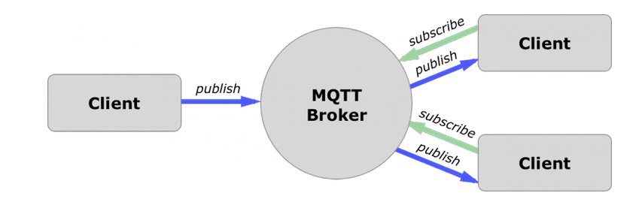
When a device (a client) wants to send data to the broker, we call this operation a “publish”.
When a device (a client) wants to receive data from the broker, we call this operation a “subscribe”.

Slide 73
Broker, which is the server that handles the data transmission between the clients.
A topic, which is the place a device want to put or retrieve a message to/from.
The message, which is the data that a device receives “when subscribing” from a topic or send “when publishing” to a topic.
Publish, is the process a device does to send its message to the broker.
Subscribe, where a device does to retrieve a message from the broker.

Slide 74
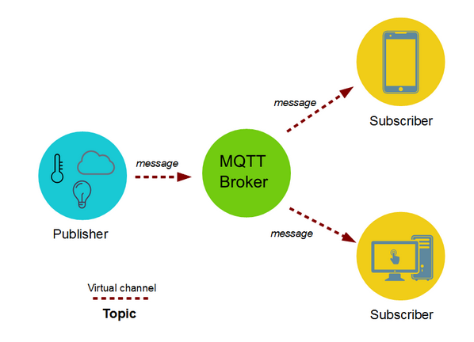

Slide 75
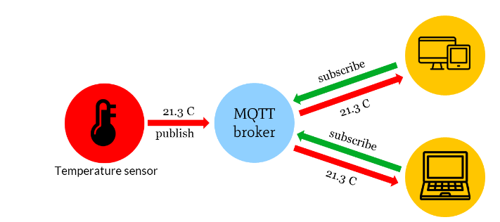

Slide 76
In this present communication world there are numerous high data rate communication standards that are available, but none of these meet the sensors’ and control devices’ communication standards. These high-data rate communication standards require low-latency and low-energy consumption even at lower bandwidths. The available proprietary wireless systems’ Zigbee technology is low-cost and low-power consumption and its excellent and superb characteristics makes this communication best suited for several embedded applications, industrial control, and home automation, and so on.

Slide 77
Zigbee communication is specially built for control and sensor networks on IEEE 802.15.4 standard for wireless personal area networks (WPANs), and it is the product from Zigbee alliance. This communication standard defines physical and Media Access Control (MAC) layers to handle many devices at low-data rates.

Slide 78
Zigbee is low-cost and low-powered mesh network widely deployed for controlling and monitoring applications where it covers 10-100 meters within the range. This communication system is less expensive and simpler than the other proprietary short-range wireless sensor networks as Bluetooth and Wi-Fi.

Slide 79
Zigbee supports different network configurations for master to master or master to slave communications. And also, it can be operated in different modes as a result the battery power is conserved. Zigbee networks are extendable with the use of routers and allow many nodes to interconnect with each other for building a wider area network.

Slide 80
Industrial Automation: In manufacturing and production industries, a communication link continually monitors various parameters and critical equipments. Hence Zigbee considerably reduce this communication cost as well as optimizes the control process for greater reliability.
Home Automation: Zigbee is perfectly suited for controlling home appliances remotely as a lighting system control, appliance control, heating and cooling system control, safety equipment operations and control, surveillance, and so on.

Slide 81
The ZigBee technology is designed to carry small amounts of data over a short distance while consuming very little power. As opposed to WiFi, it's a mesh networking standard, meaning each node in the network is connected to each other.

Slide 82
Bluetooth is a wireless technology standard that is used to exchange data over short distances (less than 30 feet), usually between personal mobile devices. This means that a Bluetooth-enabled device such as a smartphone is able to communicate with other Bluetooth devices, such as a wireless headset or printer. Bluetooth, therefore, acts much like a cord between the two devices by creating a secure, wireless personal area network in which these devices can communicate.

Slide 83
LoRaWAN (Long Range Wide Area Network) is a protocol for wide area networks. It is designed to support huge networks (e.g. smart cities) with millions of low-power devices.
LoRaWAN can provide low-cost mobile and secure bidirectional communication.
Range: 2-5km (urban area), 15km (suburban area)

Slide 84
Wi-Fi is the technology for radio wireless networking of devices. It offers fast data transfer and is able to process large amounts of data.
This is the most popular type of connectivity in LAN environments.
Range: Approximately 50m
Data Rates: 150-200Mbps, 600 Mbps maximum

Slide 85
Zigbee is a low-power, low data-rate wireless network used mostly in industrial settings.
The Zigbee Alliance even created the universal language for the Internet of Things — Dotdot — which makes it possible for smart objects to work securely on any network and seamlessly understand each other.
Range: 10-100m
Data Rates: 250kbps

Slide 86
Bluetooth is a short-range communications technology integrated into most smartphones and mobile devices, which is a major advantage for personal products, particularly wearables.
protocol for IoT apps — Bluetooth Low-Energy (BLE), or Bluetooth Smart.
It is designed to reduce power consumption.
Range: 50-150m (Smart/BLE)
Data Rates: 1Mbps (Smart/BLE)

Slide 87
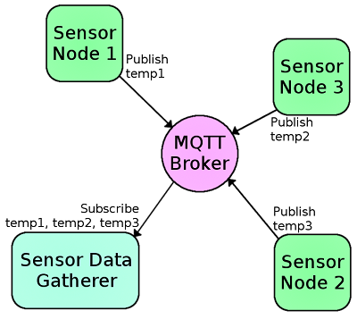

Slide 88
Broker - The broker is the server that distributes the information to the interested clients connected to the server.
Client - The device that connects to broker to send or receive information.
Topic - The name that the message is about. Clients publish, subscribe, or do both to a topic.

Slide 89
Publish - Clients that send information to the broker to distribute to interested clients based on the topic name.
Subscribe - Clients tell the broker which topic(s) they're interested in. When a client subscribes to a topic, any message published to the broker is distributed to the subscribers of that topic. Clients can also unsubscribe to stop receiving messages from the broker about that topic.

Slide 90
QoS - Quality of Service.
Each connection can specify a quality of service to the broker with an integer value ranging from 0-2. The QoS does not affect the handling of the TCP data transmissions, only between the MQTT clients.
0 specifies at most once, or once and only once without requiring an acknowledgment of delivery. This is often referred to as fire and forget.
1 specifies at least once. The message is sent multiple times until an acknowledgment is received, known otherwise as acknowledged delivery.
2 specifies exactly once. The sender and receiver clients use a two level handshake to ensure only one copy of the message is received, known as assured delivery.

Slide 91
In MQTT, the word topic refers to an UTF-8 string that the broker uses to filter messages for each connected client. The topic consists of one or more topic levels. Each topic level is separated by a forward slash.
UTF stands for Unicode Transformation Format. The '8' means it uses 8-bit blocks to represent a character.

Slide 92
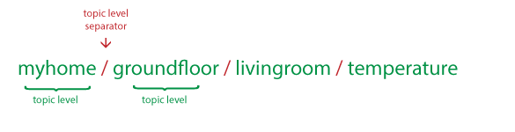

Slide 93
The client does not need to create the desired topic before they publish or subscribe to it. The broker accepts each valid topic without any prior initialization.
Note that each topic must contain at least 1 character and that the topic string permits empty spaces. Topics are case-sensitive. For example, _myhome/temperature and _MyHome/Temperature are two different topics.

Slide 94
When a client subscribes to a topic, it can subscribe to the exact topic of a published message or it can use wildcards to subscribe to multiple topics simultaneously. A wildcard can only be used to subscribe to topics, not to publish a message.

Slide 95
Single Level: +
As the name suggests, a single-level wildcard replaces one topic level. The plus symbol represents a single-level wildcard in a topic.
Any topic matches a topic with single-level wildcard if it contains an arbitrary string instead of the wildcard. For example a subscription to _myhome/groundfloor/+/temperature can produce the following results:

Slide 96
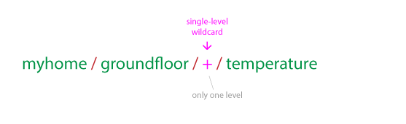
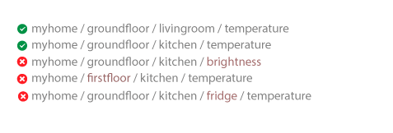

Slide 97
Multi Level: #
The multi-level wildcard covers many topic levels. The hash symbol represents the multi-level wild card in the topic. For the broker to determine which topics match, the multi-level wildcard must be placed as the last character in the topic and preceded by a forward slash.

Slide 98
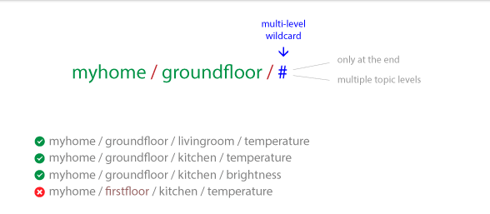

Slide 99
When a client subscribes to a topic with a multi-level wildcard, it receives all messages of a topic that begins with the pattern before the wildcard character, no matter how long or deep the topic is.
If you specify only the multi-level wildcard as a topic (_#), you receive all messages that are sent to the MQTT broker.

Slide 100
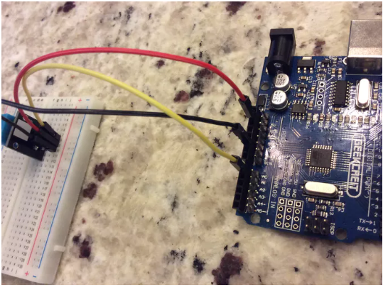

Slide 101
#include <dht.h>
#define dht_apin A0 // Analog Pin sensor is connected to
DHTesp dht;
void setup(){
Serial.begin(9600);
delay(500);//Delay to let system boot
Serial.println("DHT11 Humidity & temperature Sensor\n\n");
delay(1000);//Wait before accessing Sensor
dht.setup(dht_apin,DHTesp:: DHT11);
}//end "setup()"

Slide 102
void loop(){
//Start of Program
Serial.print("Current humidity = ");
Serial.print(DHT.getHumidity());
Serial.print("% ");
Serial.print("temperature = ");
Serial.print(DHT.getTemperature);
Serial.println("C ");
delay(5000);//Wait 5 seconds before accessing sensor again.
}// end loop

Slide 103
IEEE 802.15.4
The Institute of Electrical and Electronics Engineers (IEEE)
802.3 is wired Ethernet
802.11 is for wireless LANs (WLANs), also known as Wi-Fi.
The 802.15 group of standards specifies a variety of wireless personal area networks (WPANs) for different applications.
802.15.1 is Bluetooth
The 802.15.4 category is the standard for low-data-rate WPANs.

Slide 104
A wireless personal area network (WPAN) is a personal, short distance area wireless network for interconnecting devices centered around an individual person's workspace.

Slide 105
ZigBee
low power, low data rate supporting wireless networking standard, which is basically used for two-way communication between sensors and control system.
covering range : 10 to 100 meters.

Slide 106
Bluetooth and Wi-Fi are high data rate communications standard supporting transfer of complex structure like media, software etc
ZigBee Technology supports transfer of simple data like that from sensors. It supports low data rate of about 250 kbps.

Slide 107
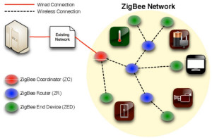

Slide 108
Zigbee system structure consists of three different types of devices such as Zigbee coordinator, Router and End device.
Every Zigbee network must consist of at least one coordinator which acts as a root and bridge of the network.

Slide 109
The coordinator is responsible for handling and storing the information while performing receiving and transmitting data operations.
Zigbee routers act as intermediary devices that permit data to pass to and fro through them to other devices.

Slide 110
Bluetooth low energy
Transferring small amounts of data between nearby devices.
Interacting with proximity sensors
lower power consumption

Slide 111
Z wave
Z-Wave is a wireless communication protocol used primarily in smart home networks,
With two-way communication through mesh networking and message acknowledgment, the Z-Wave protocol helps alleviate power issues and brings low-cost wireless connectivity to home automation, offering a lower-power alternative to Wi-Fi and a longer-range alternative to Bluetooth.

